Slide 1
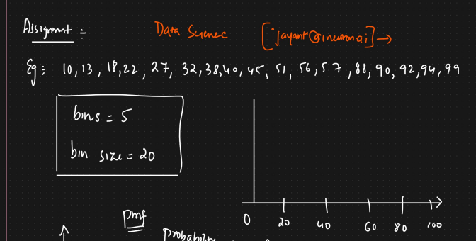
Full Stack Data Analytics : Assignment (19 June 2022)

Slide 2
Solution : Histogram
5
4
3
2
1
0
20
40
60
80
100

